Slide 1
CE 3372 Water Systems Design
Lesson 15: IDF-For Preliminary design on small sub-catchments

Slide 2








Outline
Hydrology
Definitions and Motivation
Hydrographs
Design Storms

Slide 3

Hydrology
“The science dealing with the occurrence, circulation, distribution, and properties of the waters of the earth and it’s atmosphere”
-Dictionary.com
Notes:
Studies the flow of water through and across surface
Hydrologic deals with rainfall while Hydraulic deals with flow of water in pipes

Slide 4
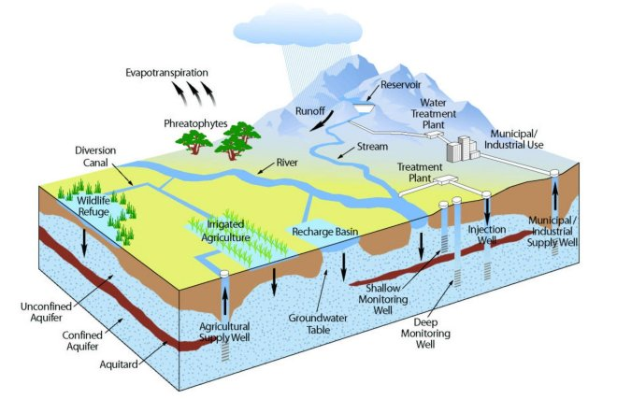
Notes:
“Hydrosphere”
Surface water + ground water

Slide 5
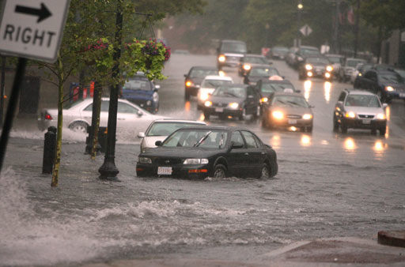
Notes:
Why is H&H engineering important??
Why do we care about runoff??
Safety. Reduce floods!
So whats the main purpose of H&H? Figuring out how to capture, store, and move the water into the ocean.
To do all of that requires calculations
HCFCD Mission: Provide flood damage reduction projects that work, with appropriate regard for community and natural values.

Slide 6
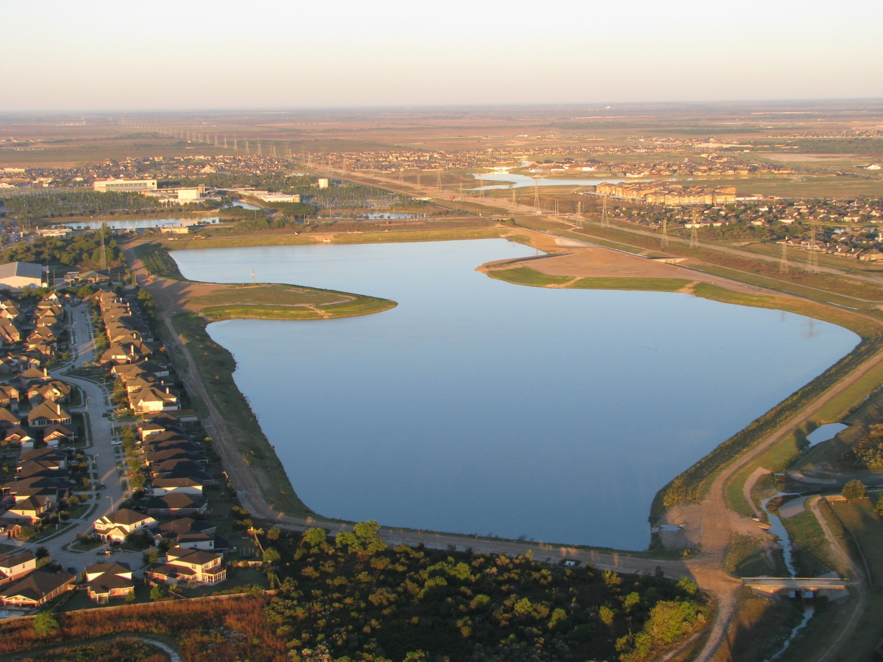
Notes:
That’s why basins are created.
Hint: those pretty “lakes” in neighborhoods and golf courses are actually detention basins.
Can you imagine what would happen if that basin was not designed properly and all those houses flooded?
So the focus is HOW do we accurately calculate rainfall runoff, HOW to capture and transport it, and HOW do we design storage spaces to hold all of the rainfall?

Slide 7
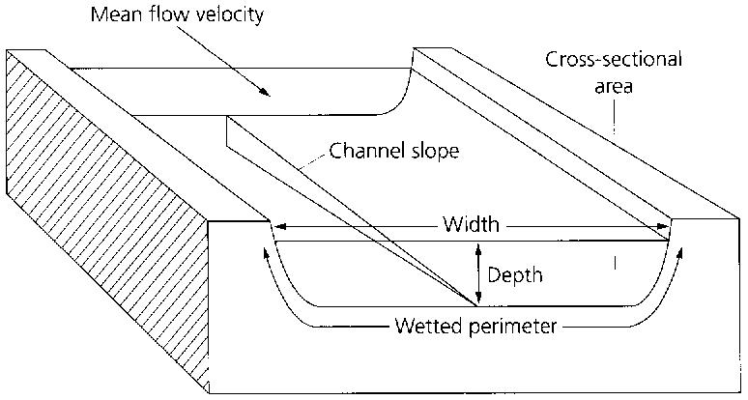
Peak Flow/Discharge
Discharge [L³/T]- Volume of water through a given cross-sectional area at a period of time
Peak flow corresponds to maximum water levels reached during a rainfall event
Flood Timelapse
Notes:
discharge is volume, at the peak discharge (the most volume of flow, it’s going to give you the max water levels and max volume you need to worry about for the storm) = width xdepthx velocity
Because the peak flow also corresponds to the maximum water level reached during the event, it is of interest in flood studies.
The stream rises to a peak flow after each precipitation event, then falls in a slow recession.

Slide 8
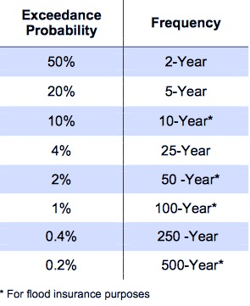
Rainfall Frequency
Frequency (Return Period) and probability (AEP) are related
Frequency (years) = 100 / Probability (%)
Ex: 2-year =100 / 50%
Notes:
Before estimating runoff, you need to choose a storm you’re designing for
*Exceedance Probability – storm has that chance of being equaled or exceeded
Potential harm vs> acceptable rish

Slide 9
Hydrographs

Slide 10
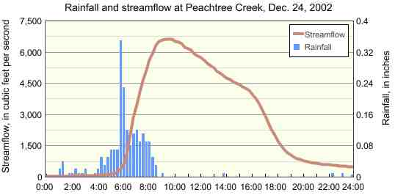
Hydrograph
Graph – Flow vs. Time
Notes:
How discharge changes over time ( min, hours, years,decade etc.)
Can be used to derive runoff from any excess rainfall on the watershed.
Assumptions
Excess rainfall has constant intensity during duration
Excess rainfall is uniformly distributed on watershed

Slide 11
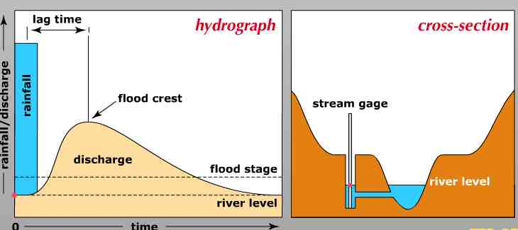
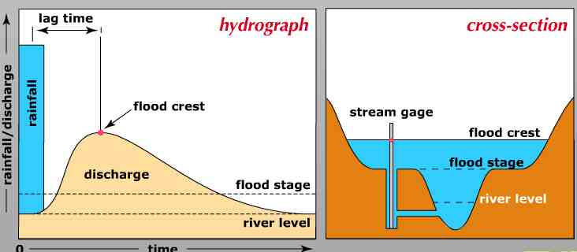
Before
Rain
After
Rain &
water
moves
to streams

Slide 12
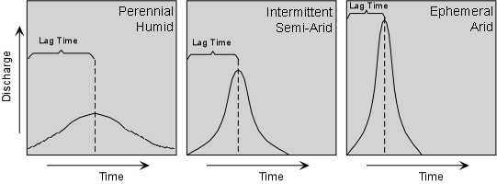
Hydrographs
Permeable Low infiltration
Notes:
Lag time is from the start of the rainfall to the PEAK discharge
Right ex: concrete urban areas

Slide 13
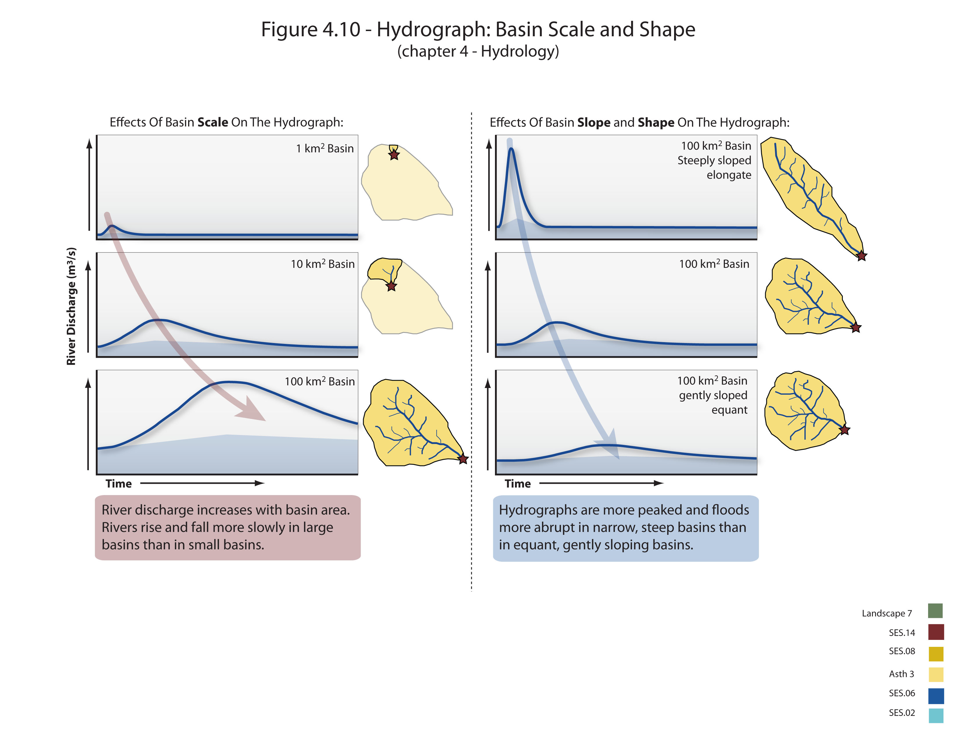

Slide 14
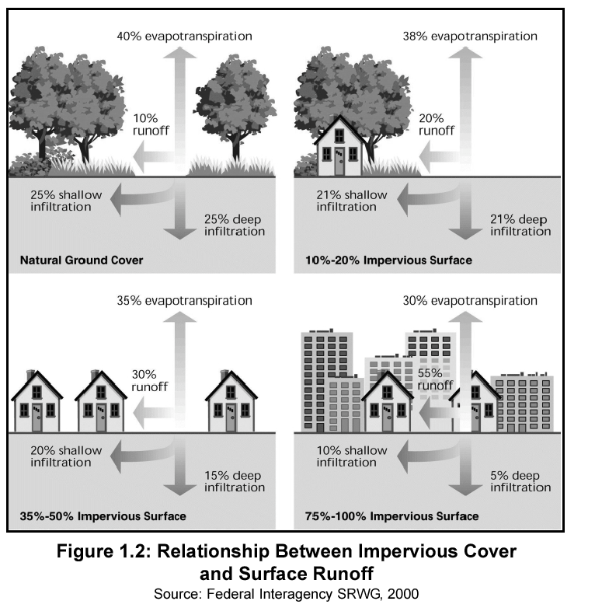

Slide 15
Design intensities

Slide 16
Precipitation
Intensity-Duration-Frequency
NOAA Atlas 14
EBDLKUP-2015 (Being replaced by a TAMU-TTI product)
Design Storms
SCS Precip. Distributions
TxHYETO-2015 (Being replaced by a TAMU-TTI product)

Slide 17
Precipitation Variables
There are four variables of engineering interest:
Intensity: how hard it rains
Duration: how long it rains at any given intensity
Frequency: how often it rains at any given intensity and duration
Spatial Distribution: the equivalent uniform rainfall depth over an area

Slide 18
Depth-Duration-Frequency
Depth of rainfall is the accumulated depth (in a gage) over some time interval.
Duration is that time interval.
Frequency is the probability (like AEP) of observing the depth over the given duration.

Slide 19
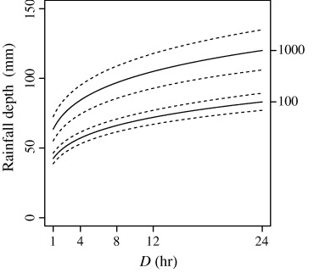
Depth-Duration-Frequency
DDF curve
e.q. 12 hour, 100-year (AEP=1%), depth is 70 millimeters
Frequency
AEP; ARI
Depth
Duration

Slide 20
Intensity
An alternate to DDF is to present the magnitude as an intensity (a rate).
Intensity is the ratio of an accumulated depth to some averaging time, usually the duration.
Intensity is NOT the instantaneous rainfall rate

Slide 21
Intensity-Depth Relationship
Intensity (average rate) from depth
e.q. 12 hour, 100-year (AEP=1%), depth is 70 mm
average intensity is 70mm/12hr = 5.8 mm/hr
Depth
Duration
Notes:
Intensity is related to depth and duration. The intensity is the ratio of depth to a particular duration. For example, if the duration or averaging time is 12 hours and the accumulated depth for 12 hours is 70 mm (about 3 inches), then the average rate is 70mm/12hours = 5.8 mm/hour. This average rate, if applied over 12 hours will produce the depth of 70mm.

Slide 22
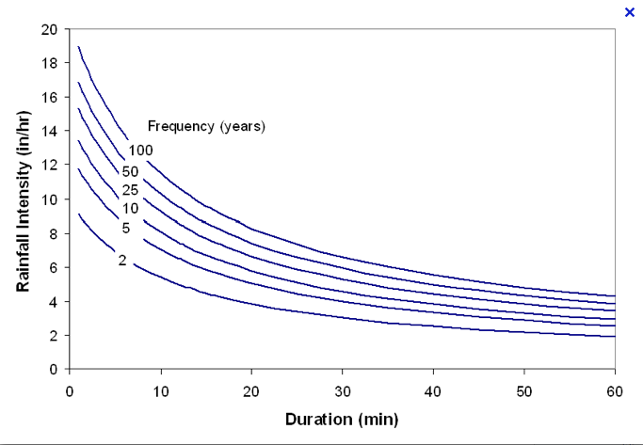
Intensity-Duration-Frequency
IDF curves
e.q. 20 min, 5-year (AEP=20%), intensity is 5.5 in/hr
Frequency
AEP; ARI
Intensity
Notes:
The family of curves that depicts the relationship between the intensity, duration, and frequency of precipitation at a point is a fundamental part of the rational equation method for storm water drainage design.

Slide 23
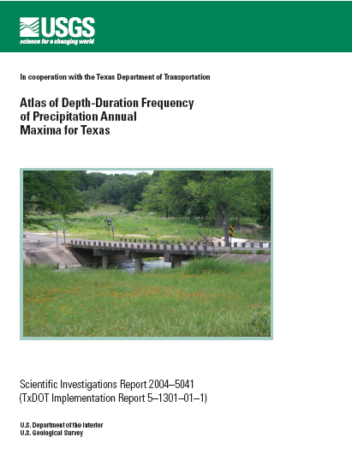
Estimating Depth and Intensity
DDF can be constructed from maps of depth for a given duration and AEP.
Such maps are available from:
NWS TP40 (online) << Deprecated
NWS HY35 (online) << Deprecated
NOAA Atlas 14 (online)
Texas DDF Atlas (online) << Deprecated
Other tools include:
EBDLKUP-2015 << Deprecated

Slide 24
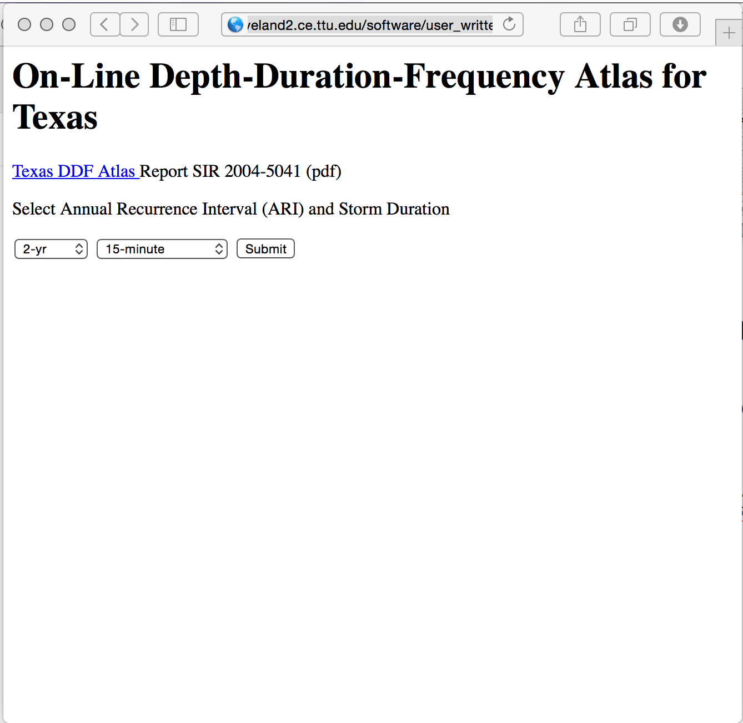
DDF Maps (Direct Access)

Slide 25
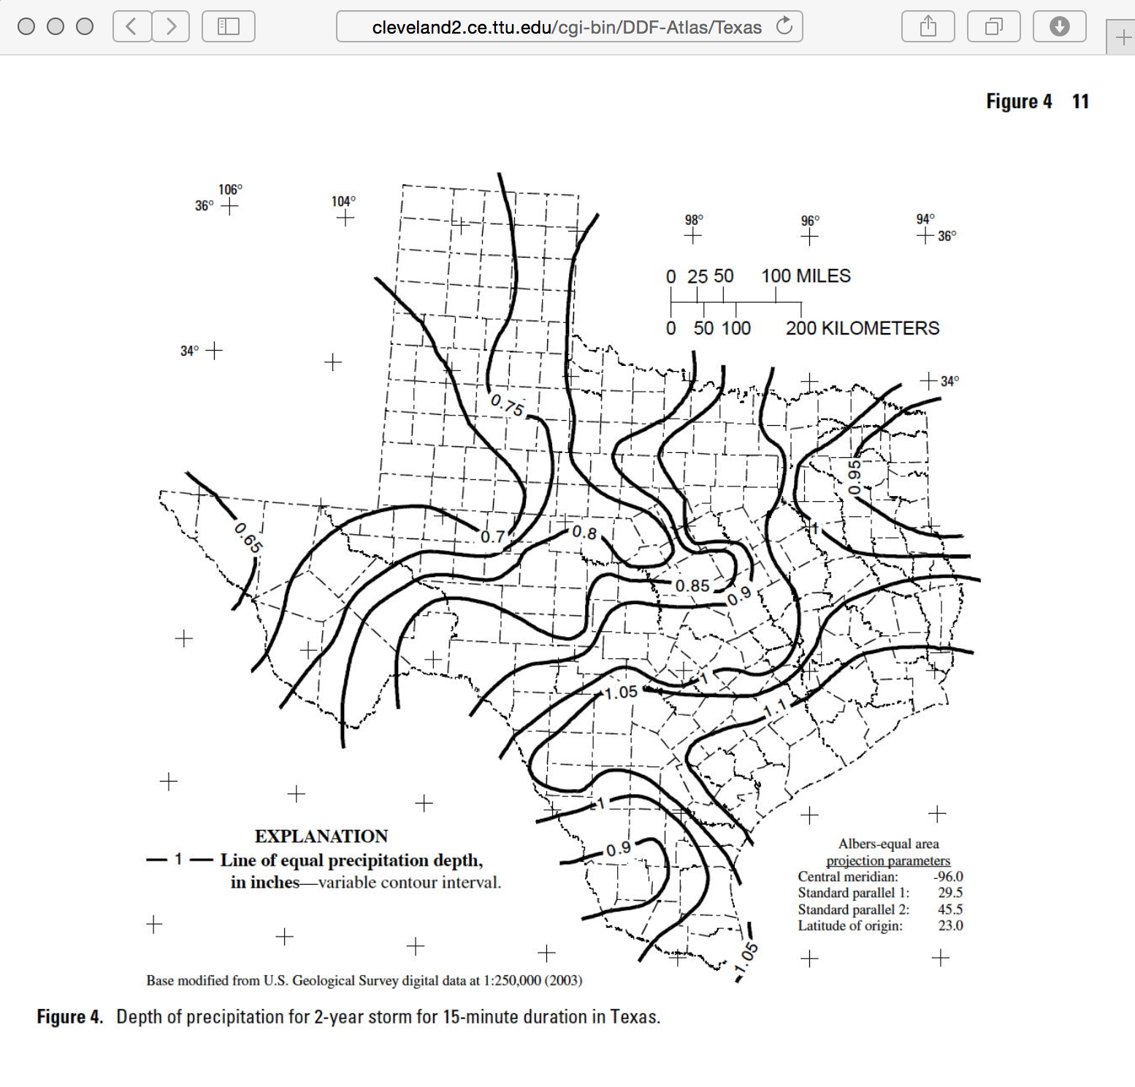
DDF Maps (Direct Access)

Slide 26
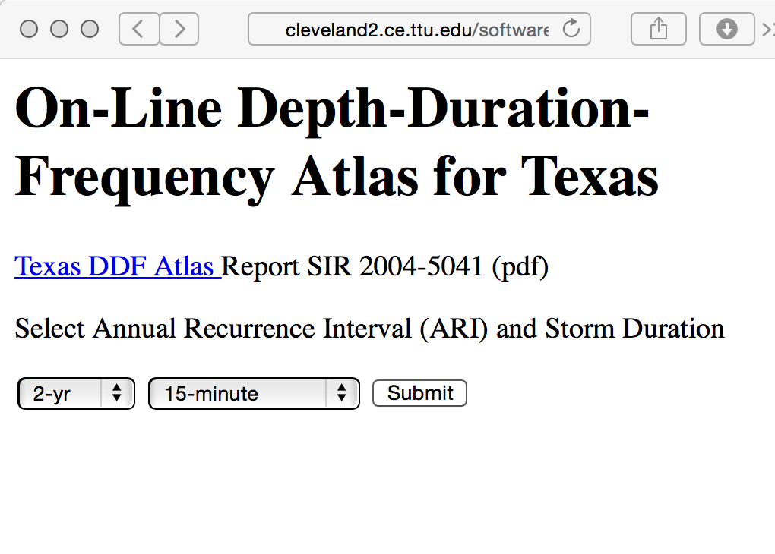
DDF Maps (Direct Access)
The interface also has a link to the original document

Slide 27
NOAA Atlas 14
A tool for use outside Texas is NOAA Atlas 14
Texas is one of a few states not yet in the Atlas
The Atlas is an on-line tool that returns tables of depths for given geographic locations
The on-line tool is called the Precipitation Frequency Data Server
http://hdsc.nws.noaa.gov/hdsc/pfds/

Slide 28
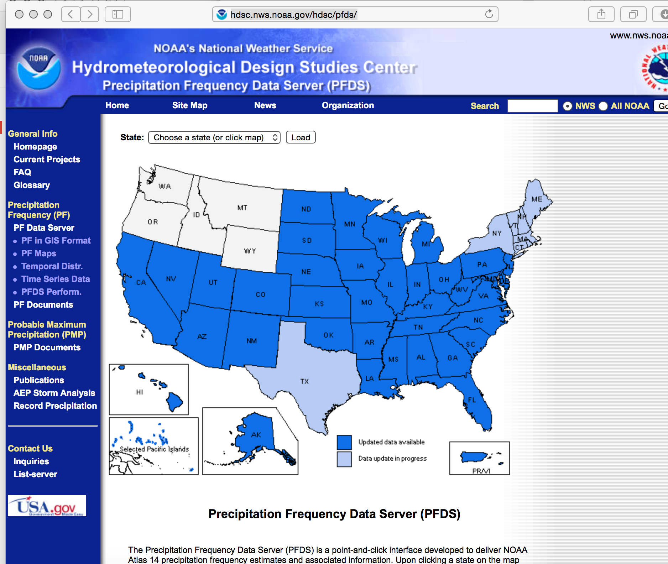
NOAA Atlas 14

Slide 29
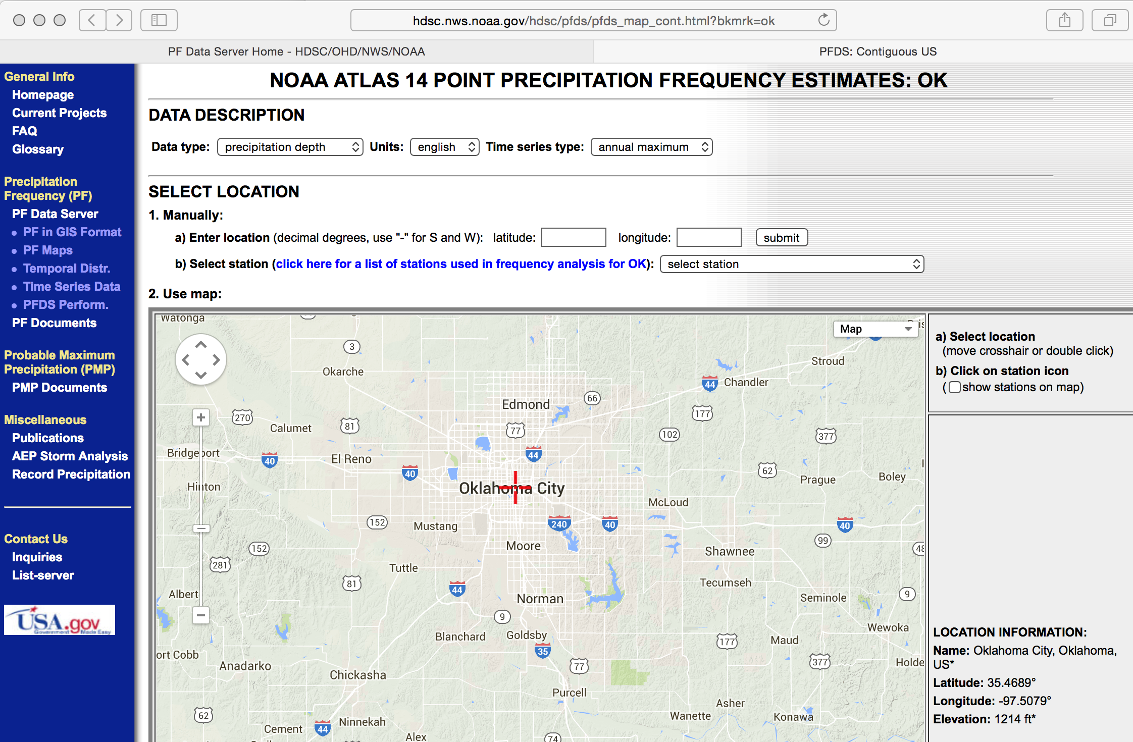
NOAA Atlas 14

Slide 30
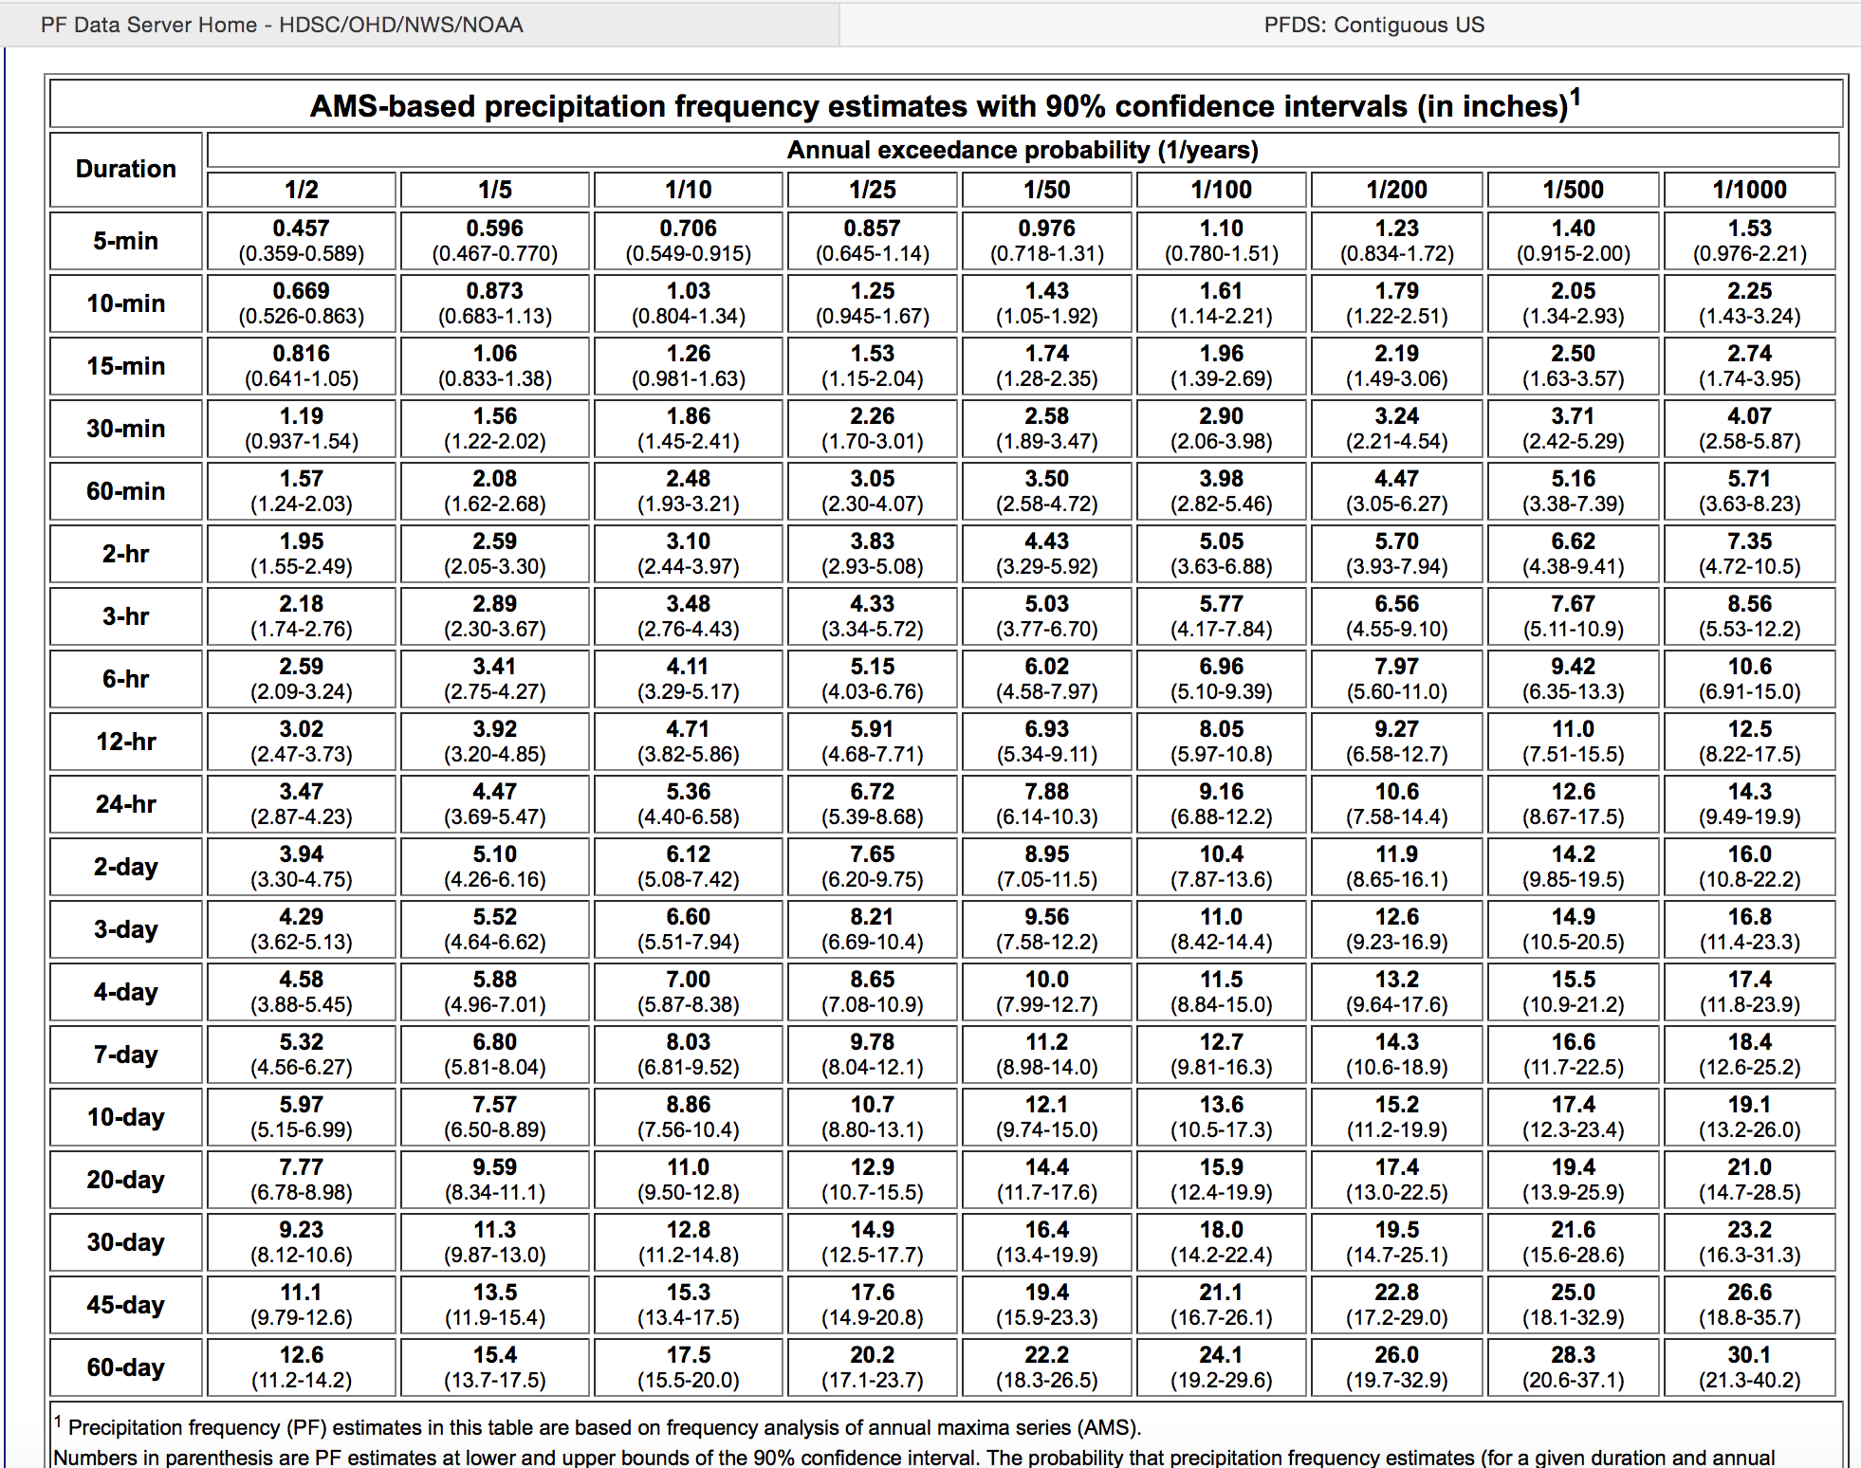
NOAA Atlas 14

Slide 31
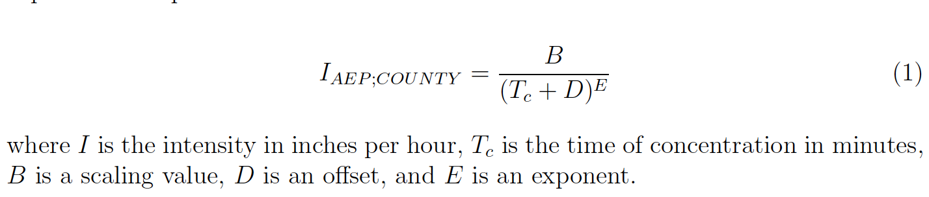
EBDLKUP-2015
EBDLKUP-2015 is a spreadsheet tool for Texas that produces intensity estimates by county for user supplied averaging times
The intensity estimates are based on the depths in the DDF Atlas
Suitable for Texas Only!

Slide 32
Depth, Intensity, and Duration
Conversion from Depth-Duration to Intensity-Duration is obtained by the ratio of depth to duration
Conversion from Intensity-Duration to Depth-Duration is obtained by multiplication
using same duration!

Slide 33
Design hyetographs

Slide 34
Hyetographs
The IDF approach only estimates average rate (over an averaging time)
When time behavior of a storm is important then we have to generate hyetographs (time series of rainfall)
Design storms are statistical models of such temporal behavior and are used in hydrologic models when hydrographs need to be generated

Slide 35
Rainfall Distributions
Rainfall distributions represent temporal patterns of a storm.
A rainfall distribution is also called a hyetograph.
Rainfall distributions are used when we need to estimate an entire hydrograph.

Slide 36
Rainfall Distributions
Each “block” represents the amount of rainfall for the time interval
The diagram is called “incremental” rainfall
The running sum of the blocks is the cumulative distribution

Slide 37
Rainfall distributions
Distributions are created from historical storms and analyzed to generate statistical models of rainfall – these models are called design storms.
Design storm distributions are typically dimensionless hyetographs
NRCS Type Storms (24 hour, 6 hour)
Empirical Texas Hyetographs (TxHYETO-2015)

Slide 38
SCS Rainfall Type Curves
SCS(1973) analyzed DDF curves to develop dimensionless rainfall temporal patterns called type curves for four different regions in the US.
SCS type curves are in the form of percentage mass (cumulative) curves based on 24-hr rainfall of the desired frequency.
Intended for use with the SCS Curve Number runoff generation model!

Slide 39
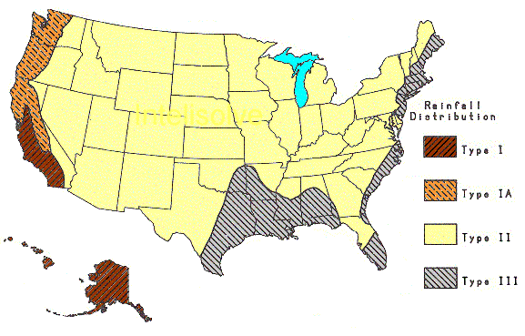
SCS Rainfall Type Curves
Location selects the Type Curve
Module 8

Slide 40
SCS Rainfall Type Curves
The 24-hour precipitation depth of desired frequency is specified (DDF Atlas), the SCS type curve is rescaled (multiplied by the known number) to get the time distribution.

Slide 41
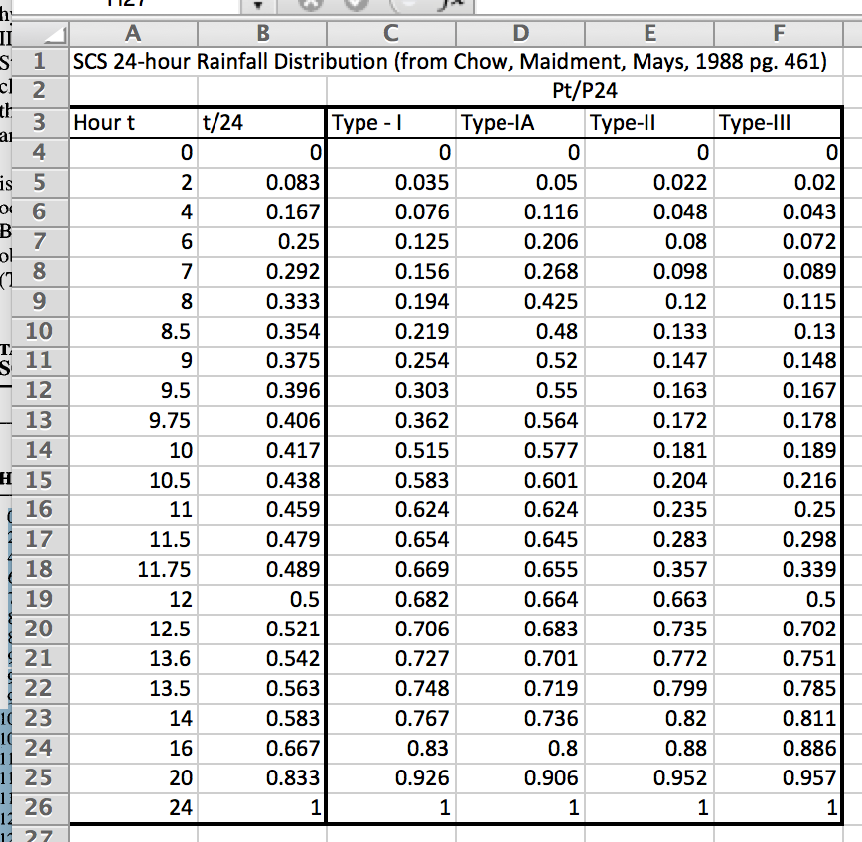
Rainfall distributions

Slide 42
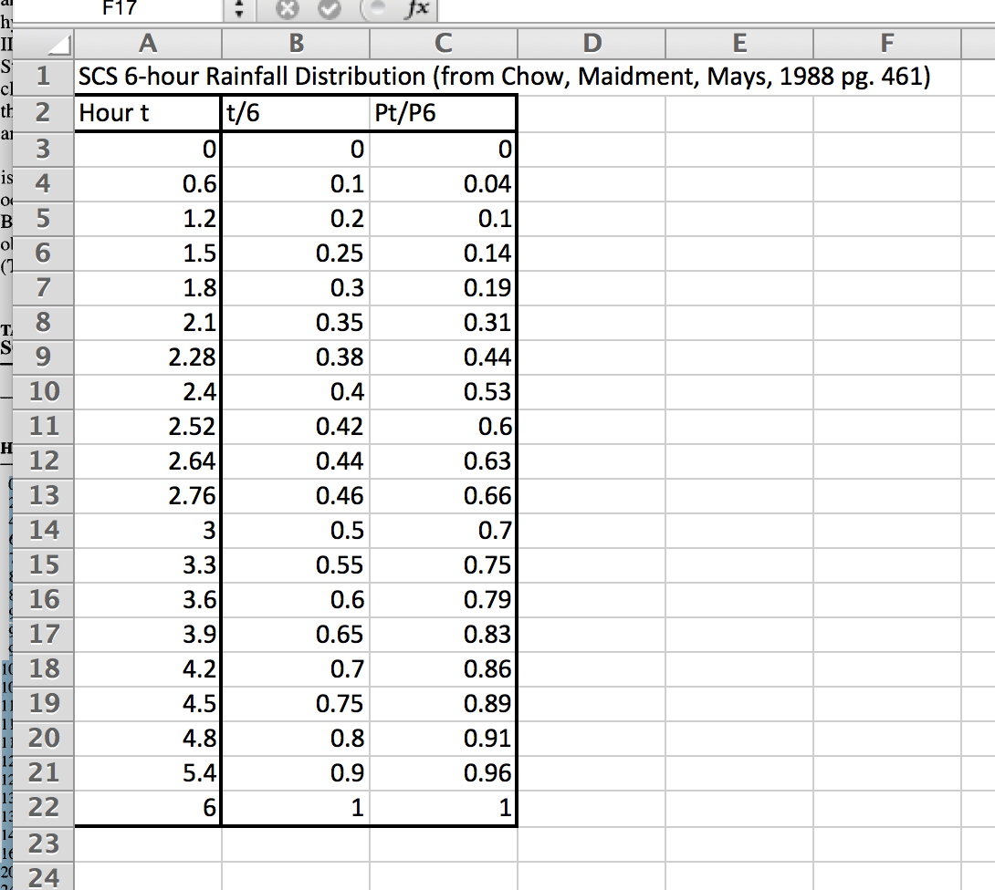
Rainfall distributions

Slide 43
SCS Rainfall Type Curves
Using the Type Curves
Use DDF Atlas, TP-40, etc. to set total depth, P for the 24 hour storm (or 6 hour storm)
Pick appropriate SCS type curve (location).
Multiply (rescale) the type curve with P to get the design mass curve.
Get the incremental precipitation from the rescaled mass curve to develop the design hyetograph.

Slide 44
Example: SCS Design Storm
Generate a design hyetograph for a 25-year, 24-hour duration SCS Type-III storm in Harris County using a one-hour time increments
Look up 24-hour,25-year depth for Harris County in the DDF Atlas.
Cumulative fraction - interpolate SCS table
Cumulative rainfall = product of cumulative fraction * total 24-hour rainfall (10.01 in)
Incremental rainfall = difference between current and preceding cumulative rainfall
Plot results of incremental

Slide 45
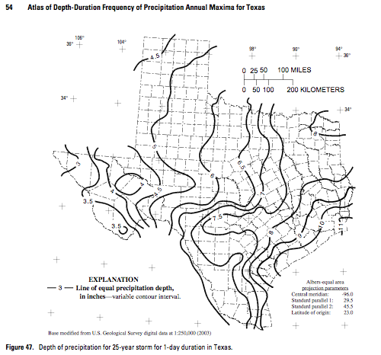
Example: Generate SCS Design Storm
Look up 24-hour,25-year depth for Harris County in the DDF Atlas.
P ~ 10 inches

Slide 46
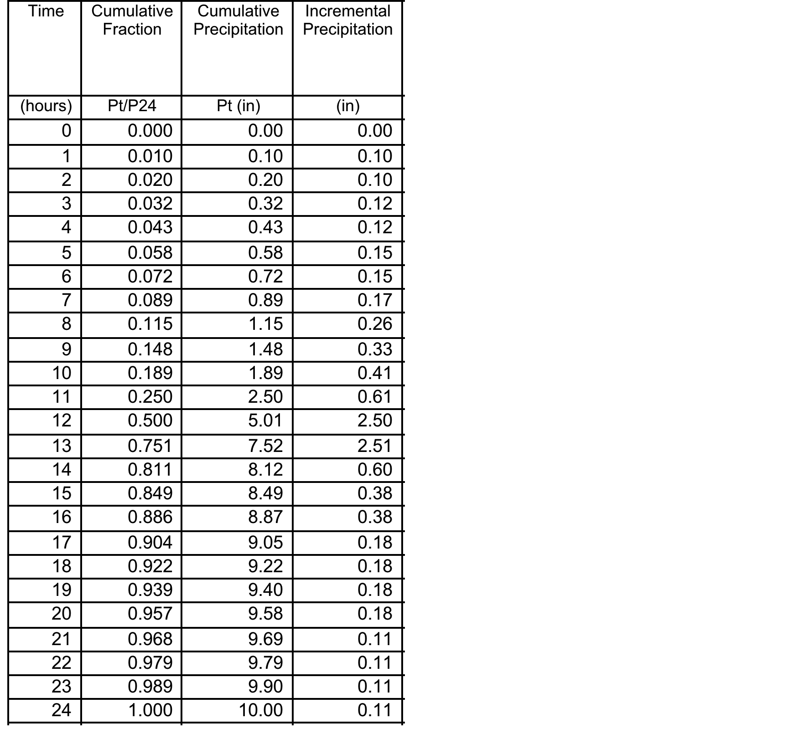
Example: SCS Design Storm
SCS Tabulation
DDF Atlas
Module 8

Slide 47
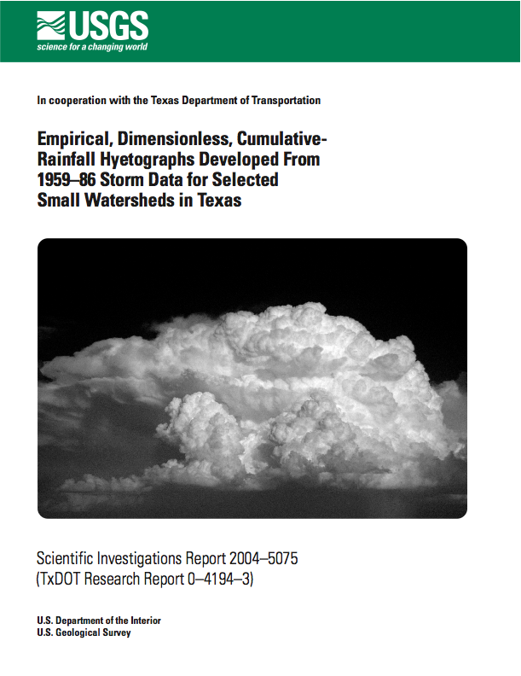
Texas Empirical Hyetographs
Alternative to SCS Type Curves is the Texas Empirical Hyetographs
Based on Texas data.
Reflects “front loading” observed in many real storms.
Rescales time and depth.

Slide 48
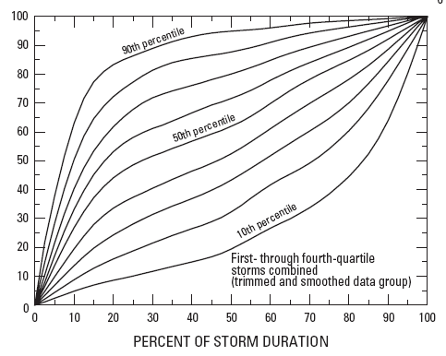
Texas Empirical Hyetographs
Rescale Depth
Average Intensity
Rescale Time

Slide 49
Texas Empirical Hyetographs
Use the 50th percentile curve (median storm).
Multiply the time axis by the storm duration.
Multiply the depth axis by the storm depth.
Result is a design storm for given duration and AEP.

Slide 50
Example: Texas Empirical Hyetographs
Construct a design storm for the 3-hour, 2-year rainfall in Harris County using the Texas Empirical Hyetograph
Obtain the depth from the DDF Atlas
Rescale the depth and time using the Texas Empirical Hyetograph
Module 8

Slide 51
Example: Texas Empirical Hyetographs
2.6 inches
1.3 inches
0 hours
1 hours
2 hours
3 hours

Slide 52
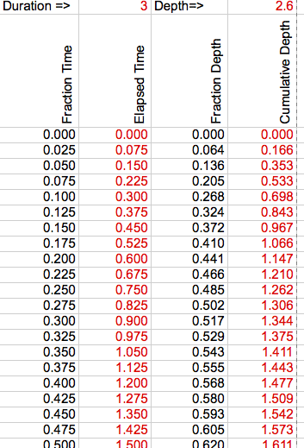
Example: Texas Empirical Hyetographs
Probably easier to use the tabulation
SIR-2004-5075

Slide 53
TxHYETO-2015
Texas Empirical Hyetograph tool that approximates the hyetographs using a function fit.
User supplies:
Depth
Duration
Desired Time Steps (increments)
Tool returns a time series of cumulative depth every increment (intended for copy-paste into HEC-HMS)

Slide 54
Hydrologic Analysis
Runoff models:
Rational Method
HCFCD Discharge-Area Curves (1960s)
TxDOT and USGS Regression Equations
SCS CN MODEL
Infiltration models
GREEN-AMPT
HORTON
Notes:
So how do we calc peak flow and volumes?
A comparison of the various methodologies shows a wide variation in computed peak discharges for similar watershed and channel conditions. On occasion, these variations lead to confusion and inconsistency among the engineering community
So diff people have diff standards. Which to pick!? It’s like a checklist
Methodology depends primarily on the drainage area of the project. In some cases, the complexity of the design or level of accuracy may influence the method selected.

Slide 55
Hydrologic Analysis
Unit hydrograph models
Clark Unit Hydrograph
Soil Conservation Service (SCS) Unit Hydrograph Method
Johnson & Sayre Curves and Generalized Regression Equations
Gamma uh (Asquith)
Notes:
So how do we calc peak flow and volumes?
A comparison of the various methodologies shows a wide variation in computed peak discharges for similar watershed and channel conditions. On occasion, these variations lead to confusion and inconsistency among the engineering community
So diff people have diff standards. Which to pick!? It’s like a checklist
Methodology depends primarily on the drainage area of the project. In some cases, the complexity of the design or level of accuracy may influence the method selected.

Slide 56
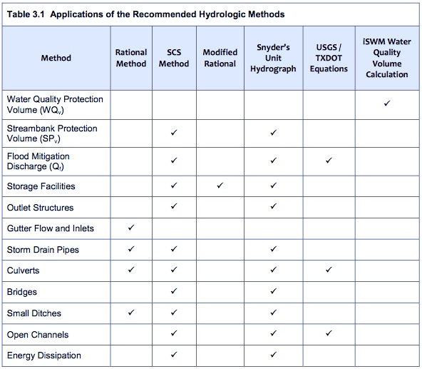
Notes:
iSWM Criteria Manual used in Dallas outlines which method you can use for which

Slide 57
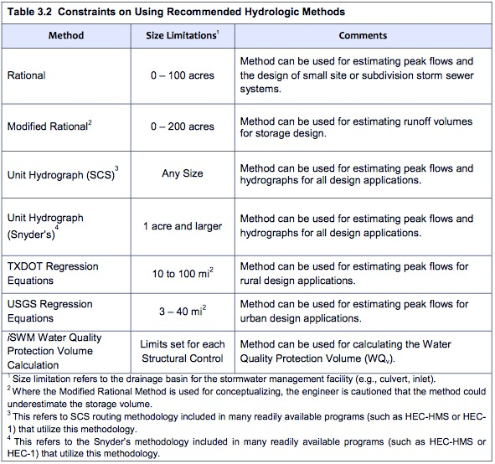
Notes:
TxDOT’s limitations are limited to watersheds 200 acres or smaller for Rational. So it varies

Slide 58
Peak discharge

Slide 59
Rational Method
Q_{p} = CiA
where
Q_{P}= peak runoff [L³/T]
C = a dimensionless coefficient
i = rainfall intensity [L/T]
A = drainage area [L²]
Notes:
Done for VERY small areas. Don’t need to create a hydrograph
TxDOTs main formula
method provides the designer with a peak discharge value, but does not provide a time series of flow nor flow volume.

Slide 60
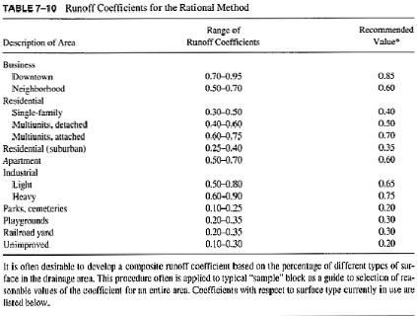
Rational Method - C

Slide 61
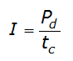
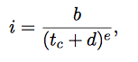
Rational Method - i
Q_{p} = CiA
Rainfall intensity (I) = total amount of rain (rainfall depth) falling over a given time of concentration [L/T]
Notes:
Explain the depth on the board.

Slide 62
Rational Method - i
P_{d} = depth of rainfall (in. or mm) for AEP design storm of duration
t_{c} = drainage area time of concentration (hr.)
Notes:
Explain the depth on the board.

Slide 63
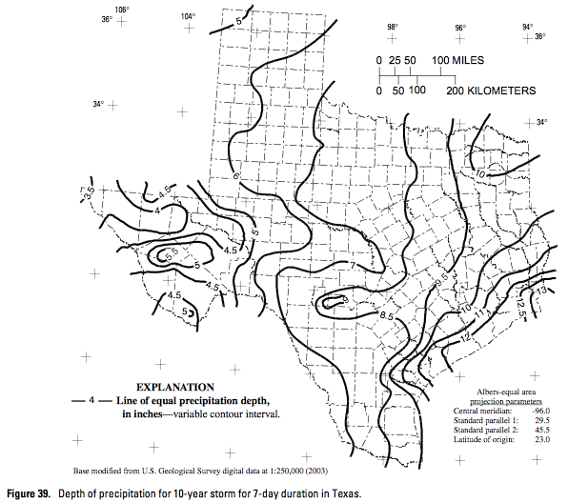
Depth-Duration Frequency
United States Geological Service Report (USGS), Asquith (1988)
Notes:
Instead of having to research different depths for different storms, it’s been done by USGS through DDF maps

Slide 64
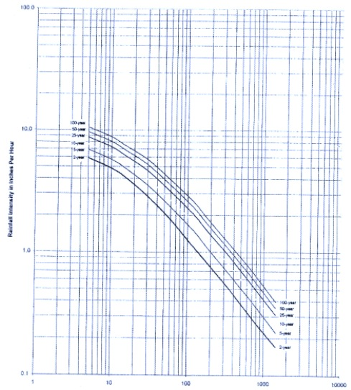
IDF Curves
Notes:
IDF Curves

Slide 65
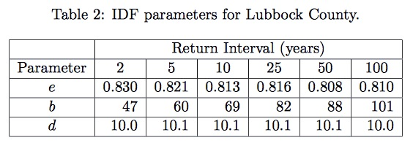
Rational Method - i
Notes:
There are different EBD values JUST for texas. On a spreadsheet called EBDLKUP

Slide 66
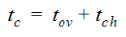
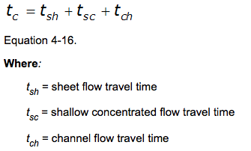
Time of Concentration (T_{c})
Time required (after start of rainfall event) for most distant point in watershed to begin contributing runoff to the watershed outlet
Typical is 10min to 300min; most jurisdictions restrict the small end to 10 (or 5 minutes)
Notes:
“In the context of the rational method then, tc represents the time at which all areas of the watershed that will contribute runoff are just contributing runoff to the outlet. That is, at tc, the watershed is fully contributing. We choose to use this time to select the rainfall intensity for application of the rational method.
If the chosen storm duration is larger than tc, then the rainfall intensity will be less than that at tc. Therefore, the peak discharge estimated using the rational method will be less than the optimal value. If the chosen storm duration is less than tc, then the watershed is not fully contributing runoff to the outlet for that storm length, and the optimal value will not be realized. Therefore, we choose the storm length to be equal to tc for use in estimating peak discharges using the rational method.
All methods for estimating tc are empirical, that is, each is based on the analysis of one or more datasets. The methods are not, in general, based on theoretical fluid mechanics. “
-Dr Thompson
Just like I theres multiple ways to calc Tc

Slide 67
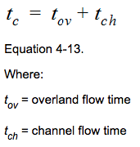

Kerby-Kirpich Method
Applicable to watersheds
area: 0.25 sq. mi. to 150 sq. mi.
main channel slopes: 0.002 to 0.02 (ft/ft)
main channel lengths: 1 to 50 miles
(Roussel et al. 2005)

Slide 68

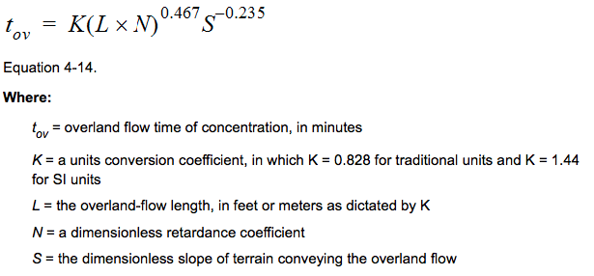
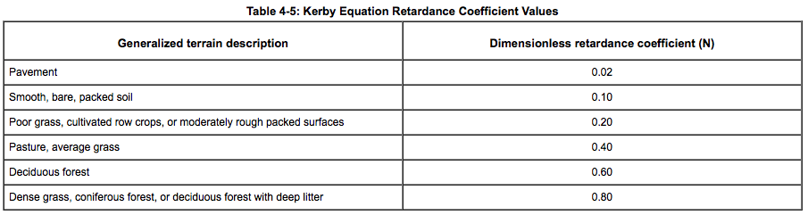

Slide 69
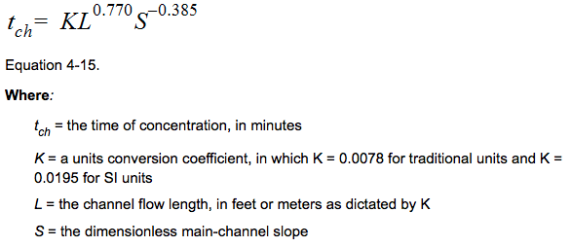

Slide 70

NRCS Method
Applicable for:
small watersheds
majority overland flow
(so timing of the peak flow is not significantly affected by the contribution flow routed through underground storm drain systems.)
Notes:
National Resources Conservation Services

Slide 71
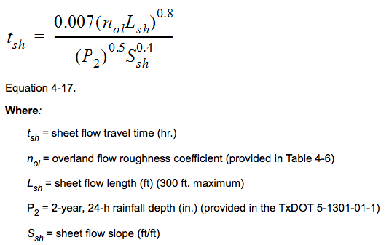

Slide 72
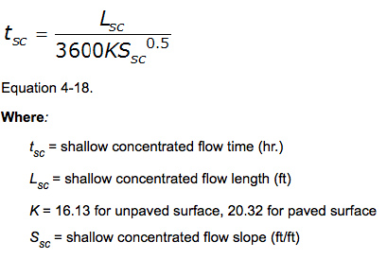

Slide 73
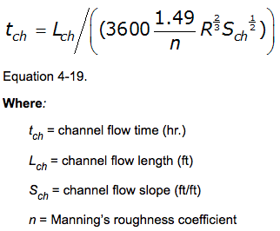

Slide 74
NRCS Upland Method
Specify flow path
Determine cover on flow path
Determine slope(s) along path
Partition into different cover types and slopes along path
Apply velocity model on each part add times for entire path

Slide 75
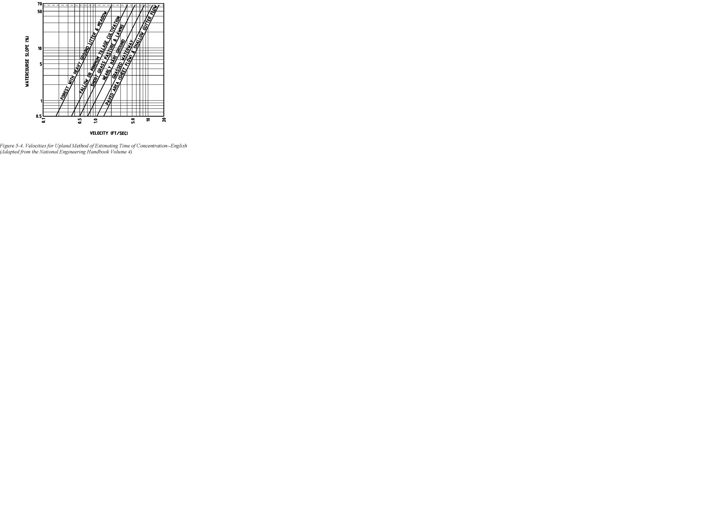
Upland Method Velocity Chart

Slide 76
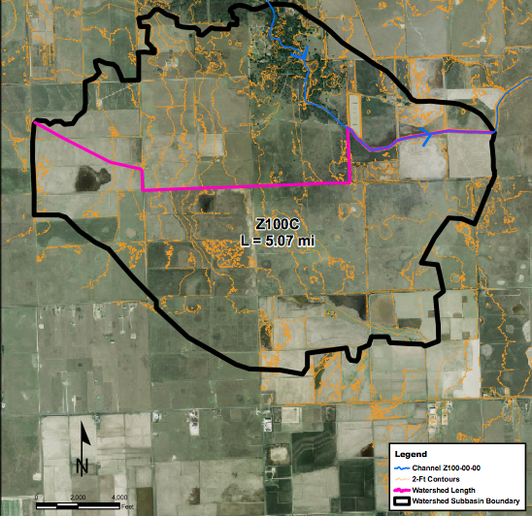
Watershed Length
Notes:
The watershed length (L) is
• the length of the longest watercourse for the subbasin.
• defined from the subbasin outflow point to the upstream subbasin
watershed boundary.
• measured along the longest definable channel and overland runoff
path, often following roadside ditches and major streets.
So if it was a small development it’s the longest flow path around houses etc.

Slide 77
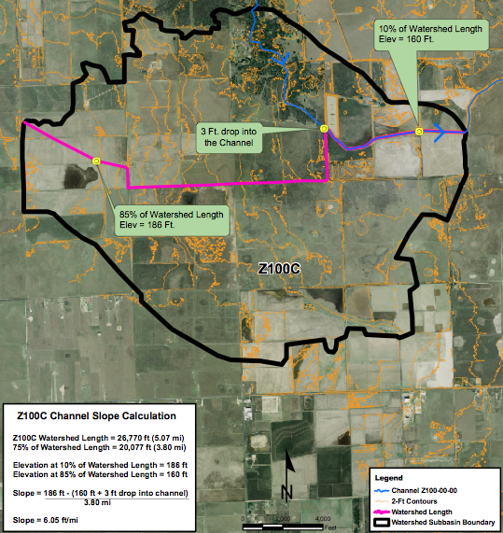
Watershed Slope

Slide 78
Rational Method
Q_{p} = CiA
Find tc to calculate intensity
Plug and chug

Slide 79
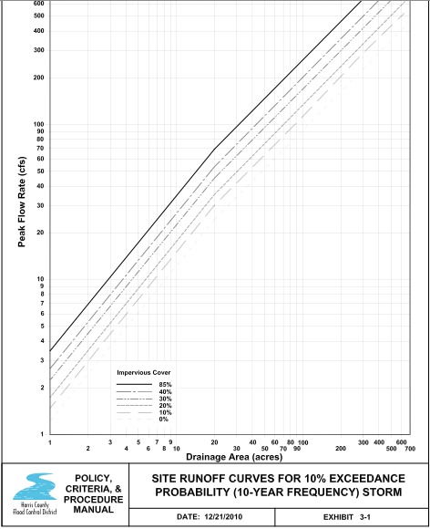
HCFCD Site Runoff Curves
Notes:
Alt method to calculating Peak Flow. HCFCD uses Site Runoff Curves.
Used for less than 640 acres

Slide 80
Regression Equations
Notes:
These are all TEXAS concepts. If you leave the state to do engineering you can’t apply these equations.

Slide 81

Texas Regression Eq.
Regression equations are used to transfer flood characteristics from gauged to ungauged sites
Done by using watershed and climatic characteristics as explanatory or predictor variables
Reliable > 10 sq. mi. drainage area
Only for non-urbanized watersheds
Other states have their OWN (Different) equations!
Notes:
Regression equations are recommended as the primary hydrologic method for off-system (non-TxDOT) projectsfor on-system projects, they are recommended as a check on other methods. Omega EM regression equations are reliable beyond 10 sq. mi. drainage area.
Regression equations are used to transfer flood characteristics from gauged to ungauged sites through the use of watershed and climatic characteristics as explanatory or predictor variables. USGS has developed such regression equations for natural basins throughout the State of Texas.

Slide 82
Texas Regression Eq.

Slide 83

Notes:
RSE, residual standard error in log10-units of cubic feet per second;
PRESS, Prediction Error Sum of Squares;

Slide 84


Slide 85

Notes:
Equations have been developed for natural basins in 1-degree latitude and longitude quadrangles in Texas.
The approach used to develop the regional equations is referred to as the “Regression Equations for Estimation of Annual Peak-Streamflow Frequency for Undeveloped Watersheds in Texas Using an L-moment-Based, PRESS-Minimized, Residual-Adjusted Approach.”
For development and use of regression equations a natural basin is defined as having less than 10 percent impervious cover, less than 10 percent of its drainage area controlled by reservoirs, and no other human-related factors affecting streamflow (USGS 2001). The equations are therefore not applicable to urban watersheds.

Slide 86
Value of Regression Equations
The regression equations are not really intended for hydraulic structure design – but:
They are useful to check that other methods are about the correct magnitude

Slide 87
NRCS Curve Number
One step up from Rational in complexity is the CN method
CN model is built-in to SWMM
Rational Method is not built-in, but a hack is presented later in the course.

Slide 88
Infiltration Models
One step up from Curve Number is an infiltration model.
Green-Ampt is quite commonly used.
GA model is built-in to SWMM
Hortonian Infiltration is also used.
Horton is built-in to SWMM

Slide 89
Example of Using Rational Equation
Estimate the peak discharge from a 200 acre, undeveloped, sandy-loam drainage area with 3-5% slope in Bexar County.
The desired AEP is 0.5 (50%).
The time of concentration is 60 minutes.

Slide 90
Required Information
Depth for 60-minute, 50% Chance storm in Bexar County, Texas.
Tc for a 200 acre parcel Given – if not would need a map and apply:
Kerby-Kirpich; NRCS Upland; or NRCS Velocity
Runoff coefficient for the parcel

Slide 91

Depth for 60-minute, 50% Chance storm in Bexar County, Texas.
DDF Atlas or EBDLKUP-2015

Slide 92
Intensity to be Applied
Tc = 60 minutes
D = 1.83 inches
Intensity = 1.83 inches/hour

Slide 93

Runoff Coefficient
Look up in Table
C=0.25

Slide 94
Compute Q_{p}
Apply equation:
Q_{p} = C i A = (0.25)(1.83 in/hr)(200 acres) = 91.5 cfs
Pay attention to units, in SI the equation has a unit conversion constant!

Slide 95
Practical Considerations
The designer will need to consider topography and flow paths to
Estimate Tc using some defensible method
Use locally relevant depth-duration-frequency tools
EBDLKUP, DDF Atlas for Texas
NOAA for elsewhere
Use meaningful runoff coefficients
Be sure applying appropriately

Slide 96
NEXT TIME
Inlets
Inlets to capture the runoff from a sub-catchment
Hydraulics consideration for:
Curb-on-grade
Curb-in-sag
Drop inlets

